Slide 1
Branch & Bound Approach

Slide 2

Branch & Bound - Introduction
This is an enhancement of backtracking.
The branch & bound design strategy is very similar to backtracking in that a state space tree is used to solve the problem.
The backtracking uses depth first search where as branch and bound uses breadth first search.
Backtracking will find all the feasible solutions where as the branch and bound is used for optimization problem and only for minimization problem. If we need to solve maximization problem, we need to convert it to minimization problem and need to apply branch and bound strategy.

Slide 3
Branch & Bound - Introduction
The branch & bound algorithm computes a number (bound) at a node to determine whether the node is promising or not
If the bound is not better than the value of the best solution found so far, the node is nonpromising. Otherwise it is promising.
Once a node is identified as nonpromising, it will not be explored further for the solution. It means, the node will be killed.

Slide 4
Branch & Bound - Introduction
Based on the order of next node exploration, BB can be classified as
1. FIFO BB – Queue is used for maintaining the order of nodes to be explored for the next level
2. LIFO BB – Stack is used for maintaining the order of nodes to be explored for the next level
3. Least Cost BB (LC-BB) – Node with LEAST COST will be explored for the next level.

Slide 5
Branch & Bound Approach 0/1 Knapsack Problem

Slide 6
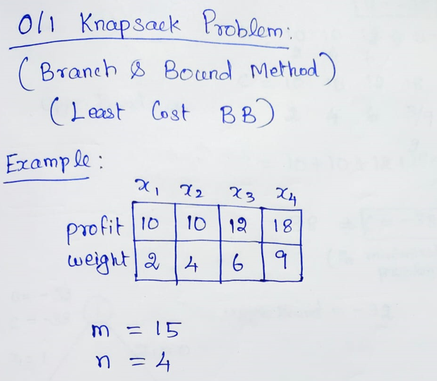

Slide 7
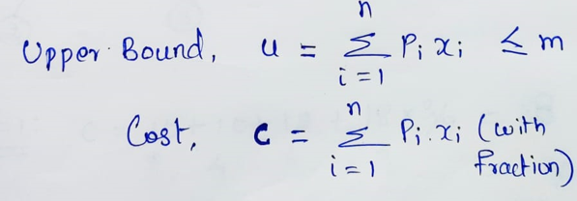
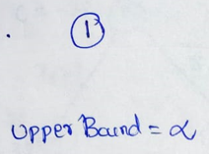
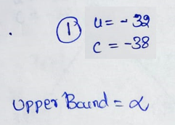
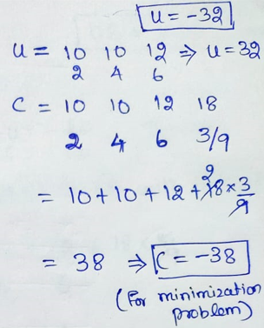
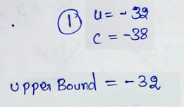
Calculate cost & upper bound for node 1
Starting with node 1
If u<Upper bound, update upper bound
Since the problem is maximizing profit
(maximization problem), it is converted
to minimization problem by
taking –ve values of u and cost

Slide 8
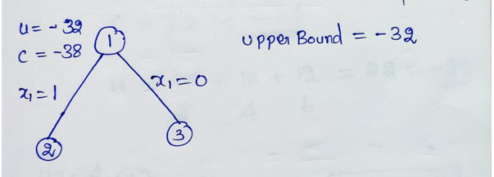
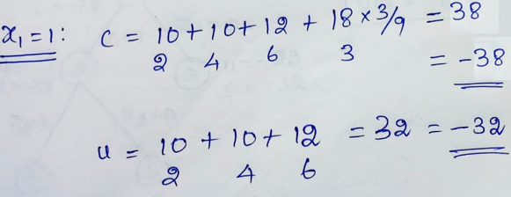
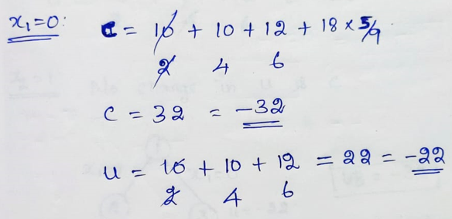
Explore node 1: 2 options – 1. x1 included (x1=1) 2. x1 excluded (x1=0)
Calculate c and u for node 2 (if x1=1)
Calculate c and u for node 3 (if x1=0)
Need to update UB(upper bound) only
If new u is less than current upper bound

Slide 9
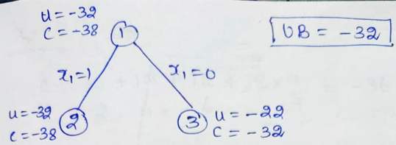
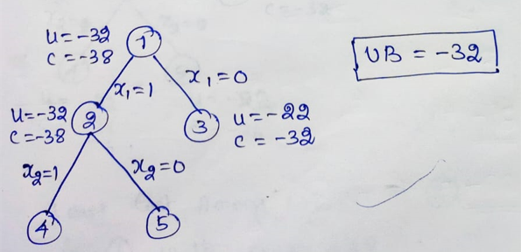
3. Choose Least Cost Node and Explore:
Need to explore one node from the nodes 2 and 3. As per LC-BB, the node 2 will be selected for exploration, because it is having least cost as -38
1. Update UB:
No change in UB,
Because, u>UB, -22>-32,
So no need to update UB
u < UB
2. Check and Kill Non-Promising Nodes
After updating UB, need to check for
any non-promising node exist.
If exist, need to kill the node.
If the cost (c) of a node is greater than UB, that node is said to be non-promising node. Kill that node. i.e., No use in exploring that node.
At this stage, there is no non-promising node among 2 and 3.
c > UB
For node 2, two more options,
1. x2 included (x2=1) 2. x2 excluded (x2=0)

Slide 10
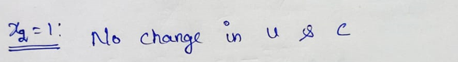
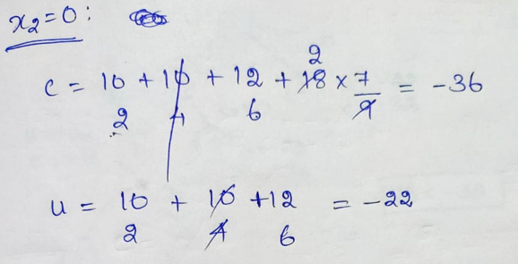
Calculate c and u for node 4 (if x2=1)
Calculate c and u for node 5 (if x2=0)
Need to update UB(upper bound) only
If new u is less than current upper bound

Slide 11
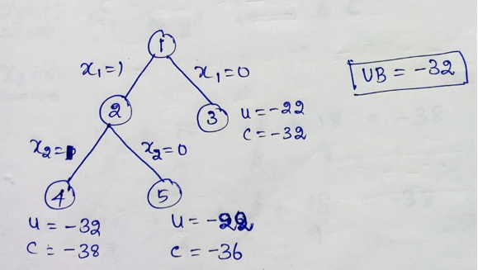
1. No change in UB,
Because, u>UB, -22>-32,
So no need to update UB.
2. No non-promising node
3. Need to explore one node from the nodes 4, 5 and 3.
As per LC-BB, the node 4 will be selected for exploration, because it is having least cost as -38

Slide 12
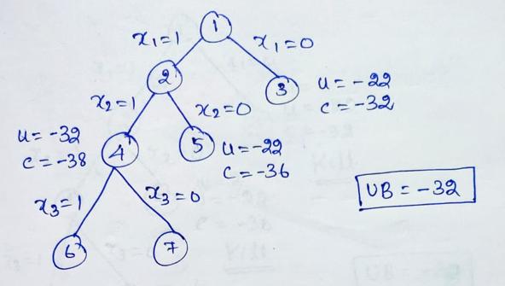
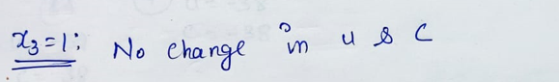
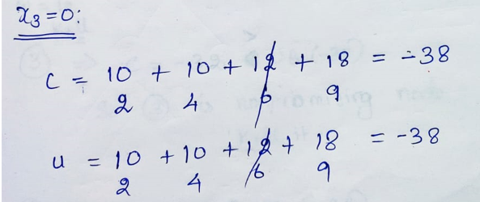
For node 4, two more options,
1. x3 included (x3=1) 2. x3 excluded (x3=0)
Calculate c and u for node 6 (if x3=1)
Calculate c and u for node 7 (if x3=0)

Slide 13
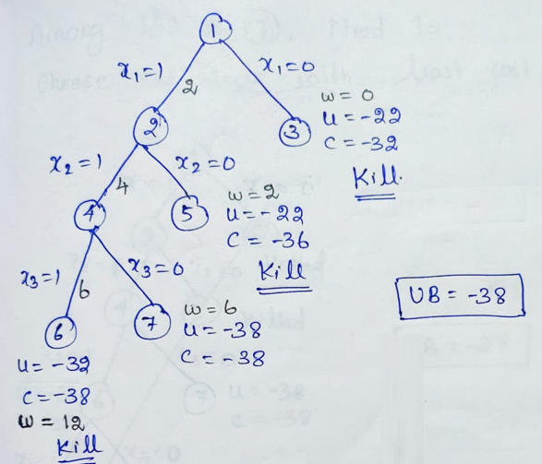
1. There is a change in UB,
Because, u<UB, -38<-32,
So need to update UB as -38
2. Check for non-promising nodes:
Before exploration of next node, need to check the bounding condition for the nodes.
Next exploration nodes nominees: 3, 5, 6 & 7
Bounding condition: If c>UB, then the node is nonpromising node, so KILL the node, no need of exploring such a node.
Node 3: c>UB, -32>-38, KILL node 3
Node 5: c>UB, -36>-38, KILL node 5
For Node 6 & 7: c=UB, both are -38, so no need to kill.
But, for the node 6, total weight so far, is 12 (2+4+6),
If next item is included, total weight 12+9=21 will exceed the bag capacity, 15. So node 6 also will get killed.
So, need to explore only node 7 now

Slide 14
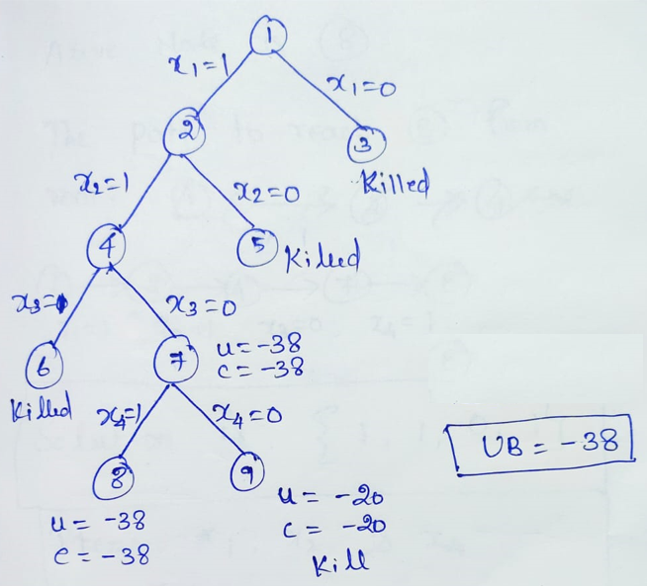
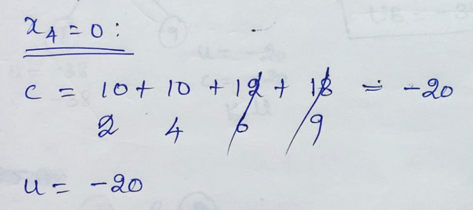
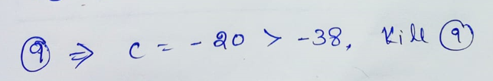

Slide 15
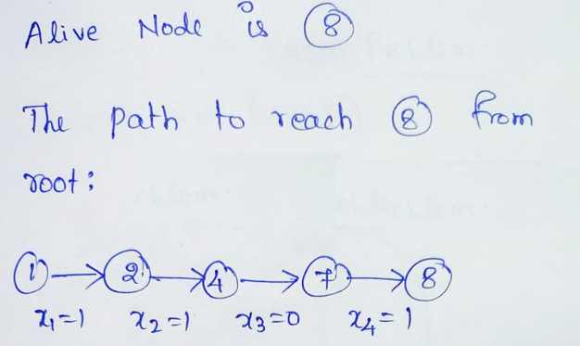
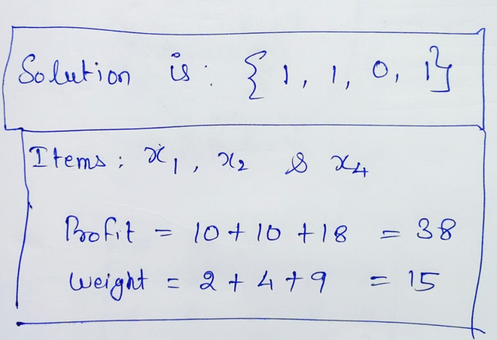

Slide 16
Branch & Bound Approach Travelling Salesman Problem

Slide 17
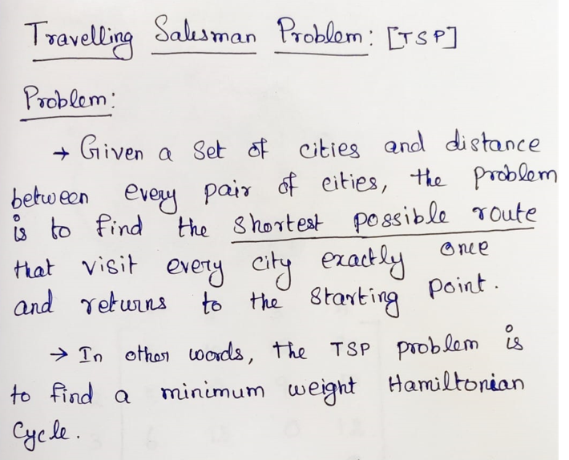

Slide 18
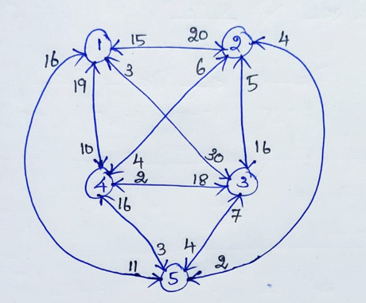
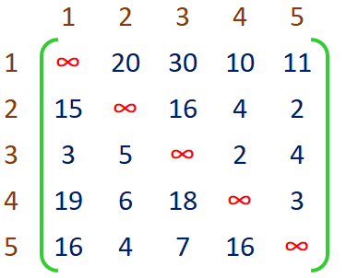
Example

Slide 19
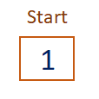
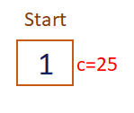
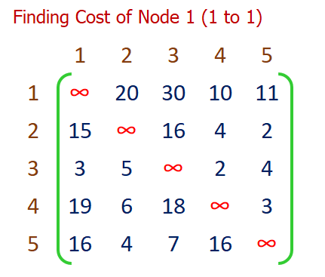

Slide 20
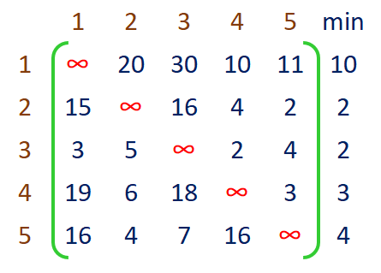
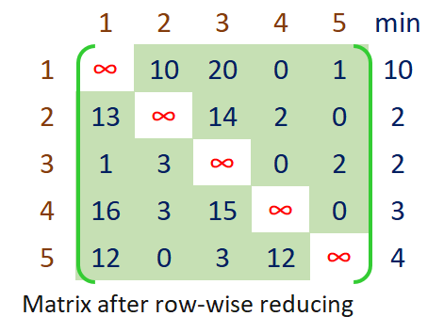

Slide 21
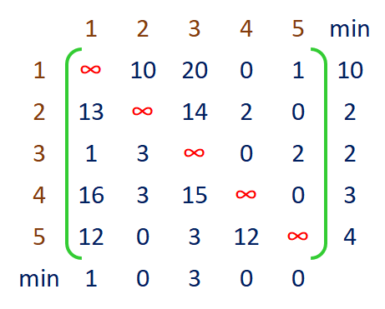
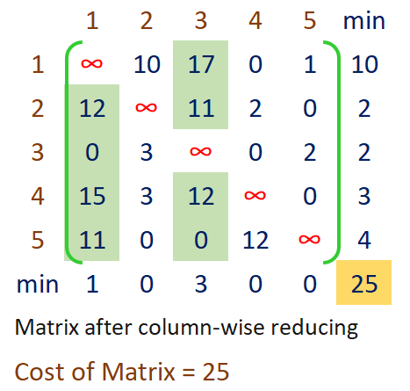

Slide 22
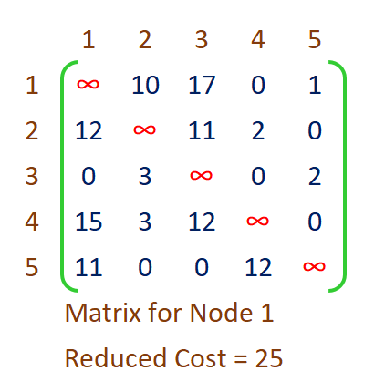
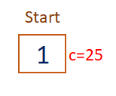
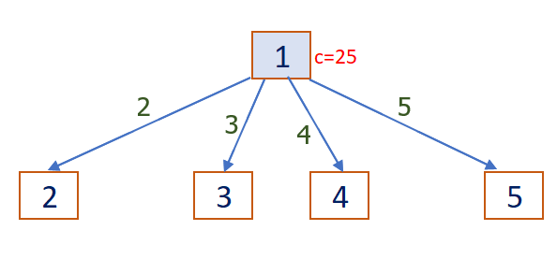

Slide 23
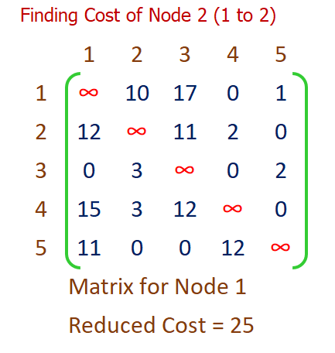
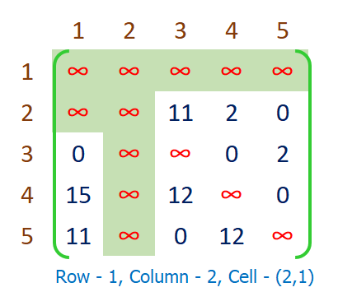

Slide 24
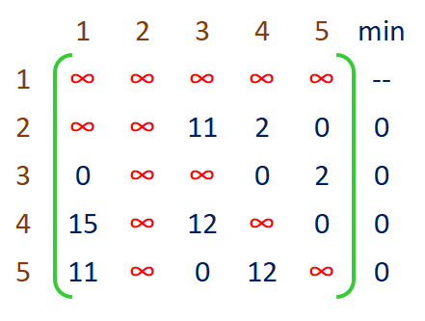
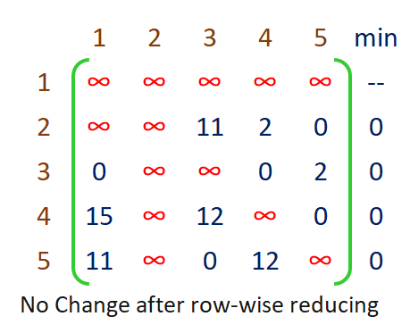

Slide 25
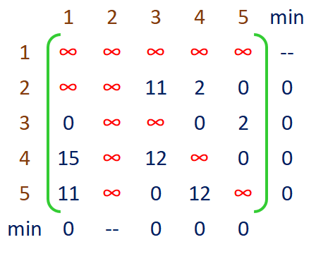
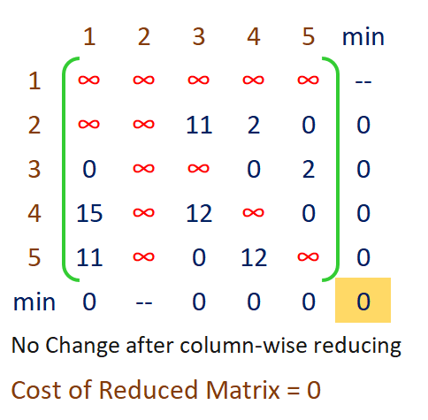

Slide 26
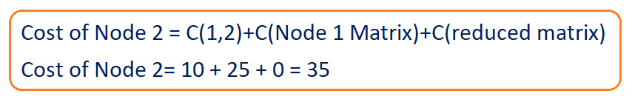
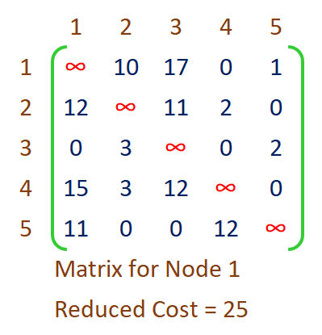

Slide 27
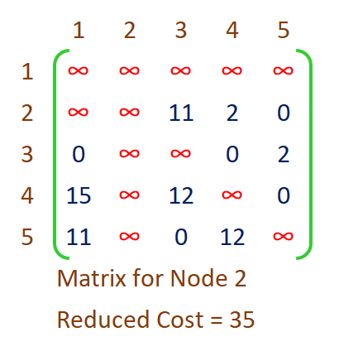
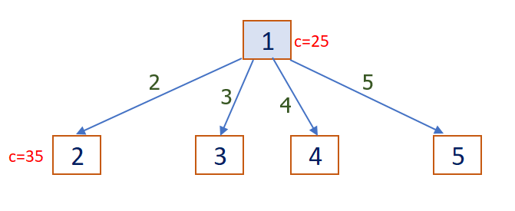

Slide 28
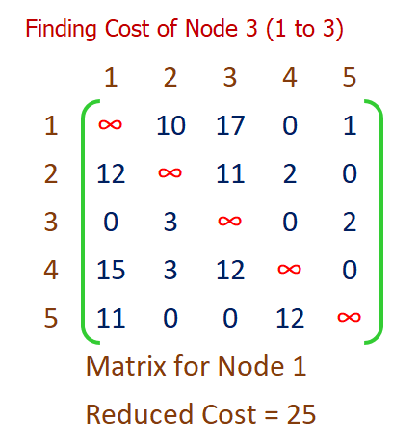
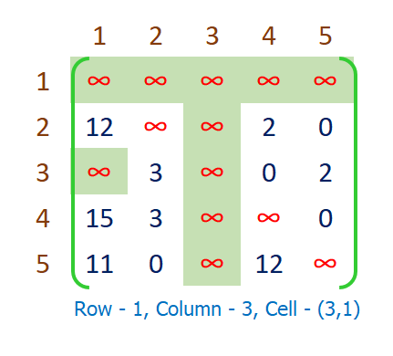

Slide 29
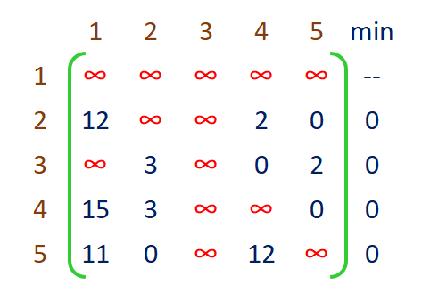
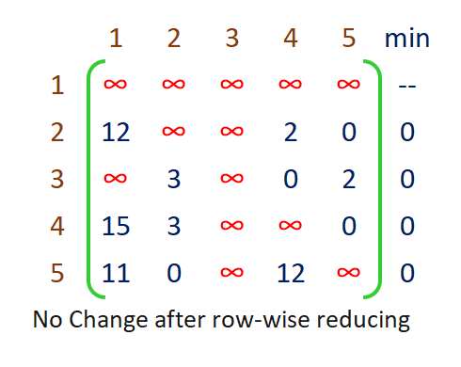

Slide 30



Slide 31




Slide 32



Slide 33



Slide 34



Slide 35




Slide 36



Slide 37



Slide 38



Slide 39




Slide 40


Slide 41


Slide 42



Slide 43



Slide 44



Slide 45




Slide 46



Slide 47



Slide 48



Slide 49




Slide 50



Slide 51



Slide 52



Slide 53




Slide 54


Slide 55


Slide 56



Slide 57



Slide 58



Slide 59




Slide 60



Slide 61


Slide 62




Slide 63


Slide 64


Slide 65



Slide 66


Slide 67




Slide 68


Slide 69



Slide 70


Result
Input Graph

Slide 71
Summary
Comparisons of followings
Divide & Conquer Vs Dynamic Programming
Dynamic Programming Vs Greedy
Brute-force Vs Backtracking
Backtracking Vs Branch & Bound
Problems & Algorithms for the following
TSP – Branch & Bound
Optimal BST – Dynamic Programming
4-Queen Problem – Backtracking
0/1 Knapsack Problem – Dynamic Programming
0/1 Knapsack Problem – Branch & Bound
TSP – Dynamic Programming
String Editing – Dynamic Programming

